Slide 1


IMDB MOVIE ANALYSIS
This Photo by Unknown Author is licensed under CC BY-SA

Slide 2

Project Description
Movie Database (IMDB) helps to gain insights into various aspects of the movie industry, Such as box office performance, genre popularity, actor/director influence, and critical reception
The project involves collecting and cleaning the data, which includes information on movie titles, release dates, box office revenue, ratings, and cast/crew members
The results of the analysis can provide valuable insights to movie studios, producers, and distributors on how to create successful movies that resonate with audiences. Additionally, the analysis can be used by movie fans to explore their favorite movies, actors, and directors and gain a deeper understanding of the movie industry.
This Photo by Unknown Author is licensed under CC BY-SA

Slide 3
Approach
Downloaded the XLS file of IMDB_MOVIES
After that cleaned the Data Set by removing bank rows, null values, duplicates and dropping some columns which were not necessary and analyzed the data and found some insights through given questions
Used filter, Pivot Table, Graphs, excel functions and different formulas to answer the questions based on statistics and probability
Then created a report in Power point and converted it into a pdf file to submit the report.

Slide 4
Tech Stack
Microsoft Excel - To Clean the data and For Functions, formulas, graphs, pivot tables to analyze the data
Power point – To generate a report and create a loom video presentation for stakeholders
Link to the Excel file –https://docs.google.com/spreadsheets/d/1Sqc3-4x4XkHMA7i7CwfV0X9wz4IgYlqC/edit?usp=sharing&ouid=107126857418427123288&rtpof=true&sd=true

Slide 5
Tasks
Movie Genre Analysis: Analyze the distribution of movie genres and their impact on the IMDB score
Movie Duration Analysis: Analyze the distribution of movie durations and its impact on the IMDB score
Language Analysis: Situation: Examine the distribution of movies based on their language
Director Analysis: Influence of directors on movie ratings
Budget Analysis: Explore the relationship between movie budgets and their financial success

Slide 6
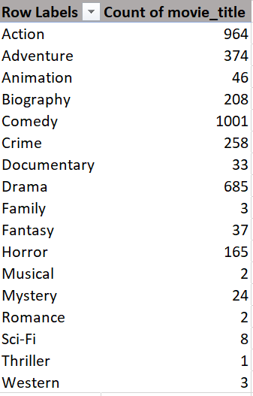
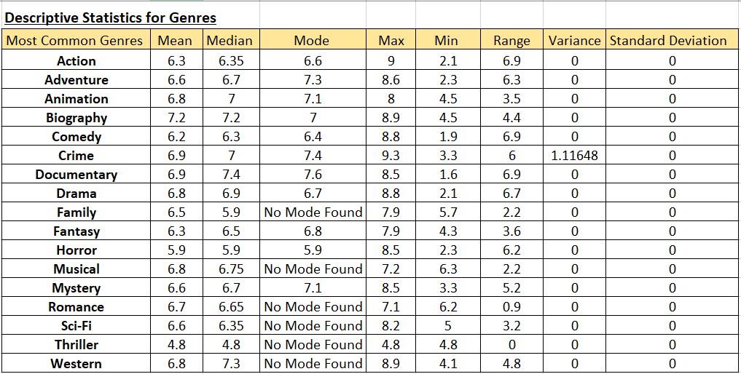
A . Movie Genre Analysis: Analyze the distribution of movie genres and their impact on the IMDB score Determine the most common genres of movies in the dataset. Then, for each genre, calculate descriptive statistics (mean, median, mode, range, variance, standard deviation) of the IMDB scores

Slide 7
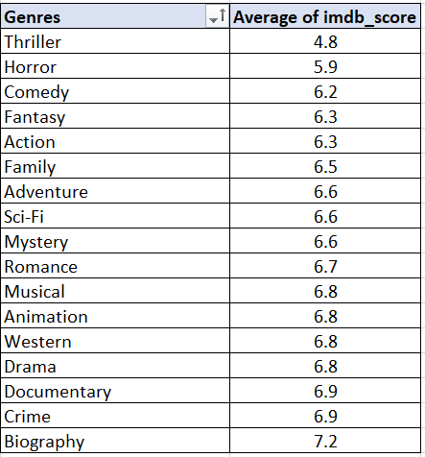
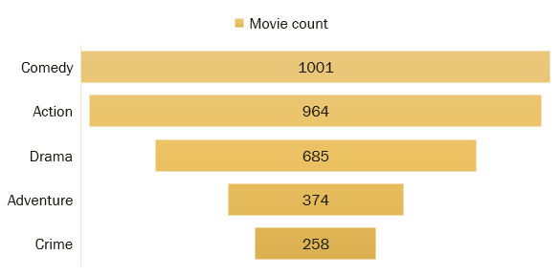
Most Common Genres
Most common genre in movies is Comedy and Action which has the least rating of 6.2 and 6.3 respectively.
But Crime and Drama has the most rating of 6.9 and 6.8 respectively

Slide 8
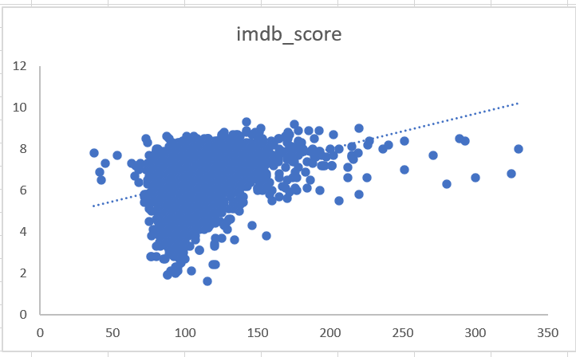
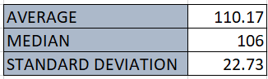
B . Movie Duration Analysis: Analyze the distribution of movie durations and its impact on the IMDB score Analyze the distribution of movie durations and identify the relationship between movie duration and IMDB score

Slide 9
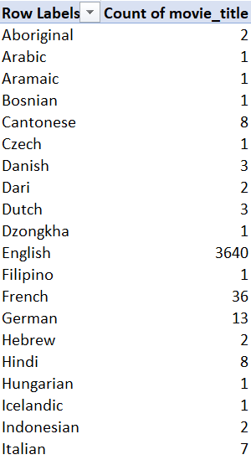
C . Language Analysis : Examine the distribution of movies based on their language. Determine the most common languages used in movies and analyze their impact on the IMDB score using descriptive statistics

Slide 10
Top 5 languages based on IMDB rating
language | count of movies | IMDB rating
English | 3640 | 6.4
French | 36 | 7.3
Spanish | 23 | 7.1
Mandarin | 15 | 7.1
German | 13 | 7.7
English is the most common language used in movies and has the lowest IMDB rating compare to other regional languages

Slide 11
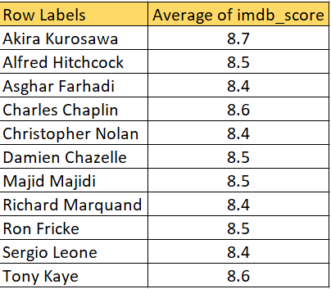
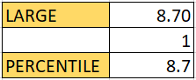
D . Director Analysis: Influence of directors on movie ratings. Identify the top directors based on their average IMDB score and analyze their contribution to the success of movies using percentile calculations
Crime,drama,comedy,action,adventure and thriller are the top genre of which these director direct movies

Slide 12
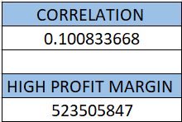
E . Budget Analysis: Explore the relationship between movie budgets and their financial success. Analyze the correlation between movie budgets and gross earnings, and identify the movies with the highest profit margin
In terms of Profitability, Horror has the highest profitability despite having low count and low IMDb followed by western then thriller
Genres like comedy, action, adventure which has relatively higher IMDb rating average makes loss
Horror genre though with highest profitability has the lowest IMDB rating average
profitability and high IMDb rating has a negative corelation of - 0.100833668
This is seen when only Alfred Hitchcock, Damien Chazelle, Majid Mjijdi, Christohper Nolan, Richard Marquand and Asghar Farhadi being profitable and not the others

Slide 13
Result
The project helped me to gain mastery in pivot tables, formulas and functions.
This project overall helped in establishing an advance understanding of MS Excel.
Improved my Statistics learnings.

Slide 14
THANK YOU!

